Slide 1

Emotion Detection on Twitter Using Transformer Models and RAG-Based Ensemble Learning
Presented by:
Harika Lakshmi Kareti
Kranthi Swapna Garapati
Neharika Rangineni

Slide 2

Project Introduction
Objective: Build a hybrid model combining BERT and Retrieval-Augmented Generation (RAG) to improve emotion detection in tweets.
Motivation: Traditional models struggle with limited tweet context. By integrating external knowledge, we aim to better understand emotional nuances.
Approach: Use fine-tuned BERT for sentiment classification enhanced with semantic retrieval from a lightweight knowledge base.
Domain: Social Media - Twitter posts
Significance: Helps in social media monitoring, brand analysis, and customer feedback understanding.

Slide 3

Dataset Overview
Dataset: Sentiment140 (Kaggle)
Contains 1.6 million tweets automatically annotated for sentiment based on emoticons.
Sentiment labels:
0: Negative (e.g., sadness, frustration)
1: Positive (e.g., happiness, satisfaction)
Each record includes tweet text, user ID, date, query string, and sentiment label.
The dataset captures real-world social media expressions, including slang, abbreviations, and informal language, making it ideal for natural language model training.
In this project, a subset of 10,000 tweets was sampled for efficient training and testing to demonstrate proof of concept.

Slide 4
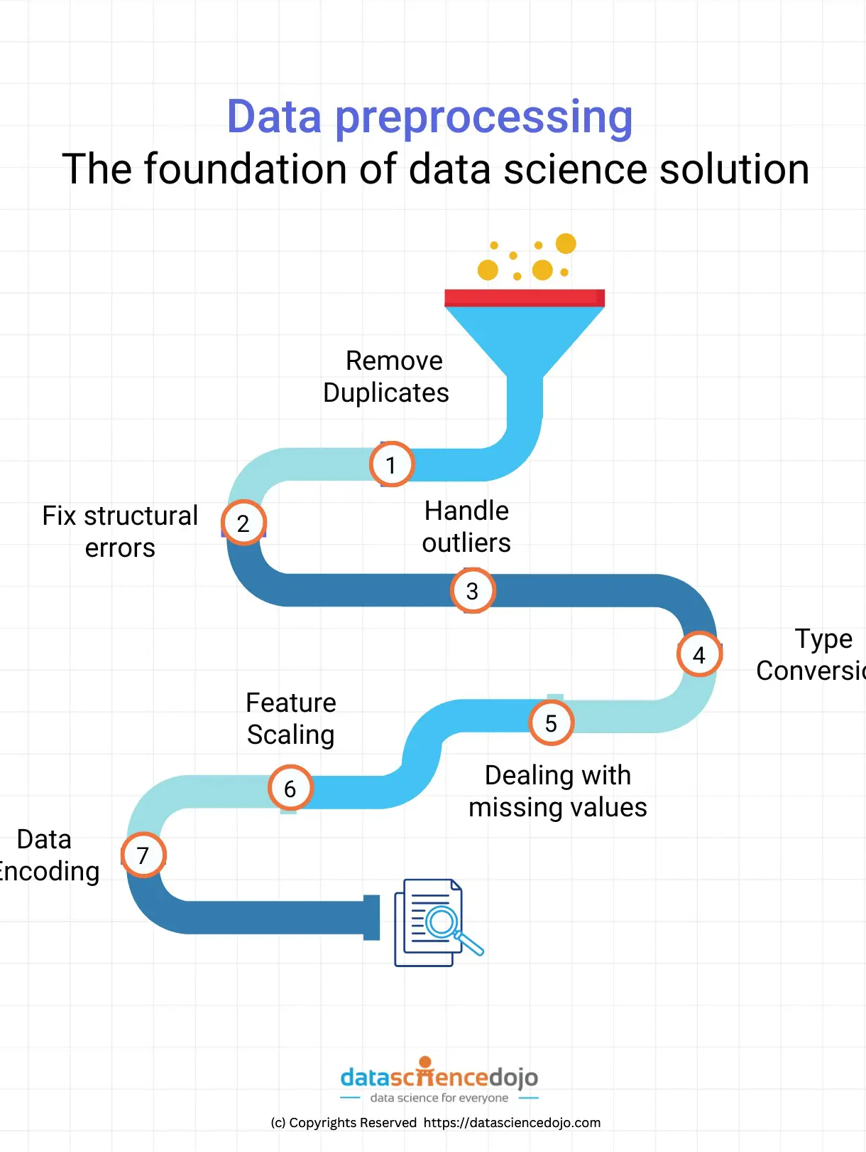
Methodology
Step 1: Data Preprocessing In this step, we clean the tweets and map the original sentiment labels (0, 2, 4) into three distinct classes (0, 1, 2), preparing the data for efficient model training and evaluation.
Step 2: Model Fine-tuning We fine-tune a pre-trained BERT-base model, adapting it to perform multi-class classification specific to the sentiment categories, using optimization techniques to ensure robust learning.
Step 3: Knowledge Base Creation We build a lightweight external knowledge base comprising emotional definitions, providing additional contextual understanding to enhance the model's ability to interpret subtle emotions.
Step 4: Retrieval-Augmented Generation (RAG) Using Sentence-BERT, we semantically encode each tweet and retrieve the most relevant context from the knowledge base, enriching the original information.
Step 5: Context Fusion and Prediction We combine the original tweet with the retrieved context and feed this enriched input into the fine-tuned BERT classifier to predict the final sentiment label with improved accuracy.

Slide 5
Model Architecture
The architecture starts with preprocessing the input tweet, followed by semantic search to retrieve relevant knowledge. The retrieved context is fused with the original tweet and passed into a fine-tuned BERT model for sentiment prediction (Negative, Neutral, Positive). This approach combines retrieval systems and deep learning for improved accuracy.
Input Tweet -> [Preprocessing]
[Semantic Search] -> Retrieve external context
[Combine Text + Context]
[Fine-tuned BERT Classifier]
Output: Sentiment Class (Negative / Neutral / Positive)

Slide 6
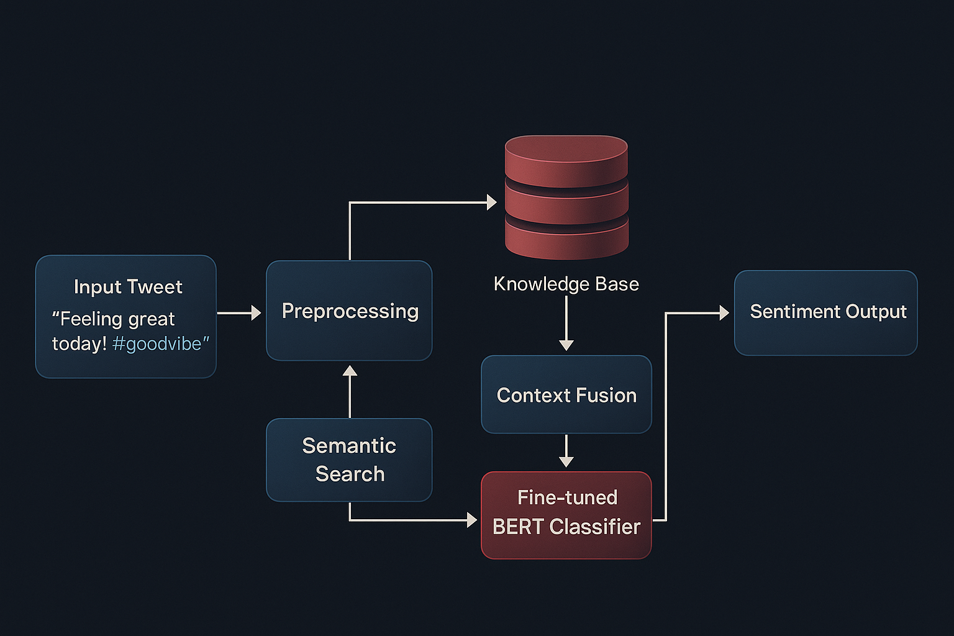
Architecture Diagram

Slide 7
Live Code Demonstration
Step 0: Install Libraries and Setup Kaggle API.
Step 1: Upload kaggle.json and Download Dataset
Step 2: Load and Prepare Dataset
Step 3: Query Encoding (Encode Tweets).
Step 4: Build Knowledge Base and Retrieval (FAISS).
Step 5: Context Fusion
Step 6: Prepare Dataset for Fine-tuning.
Step 7: Fine-tune Transformer Model (Classification).

Slide 8
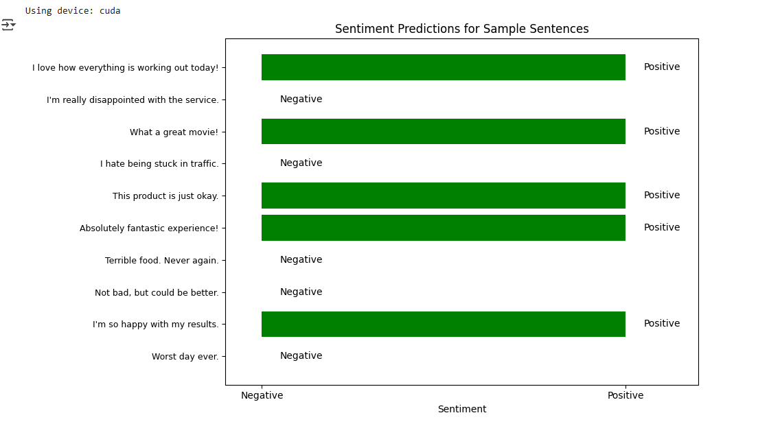
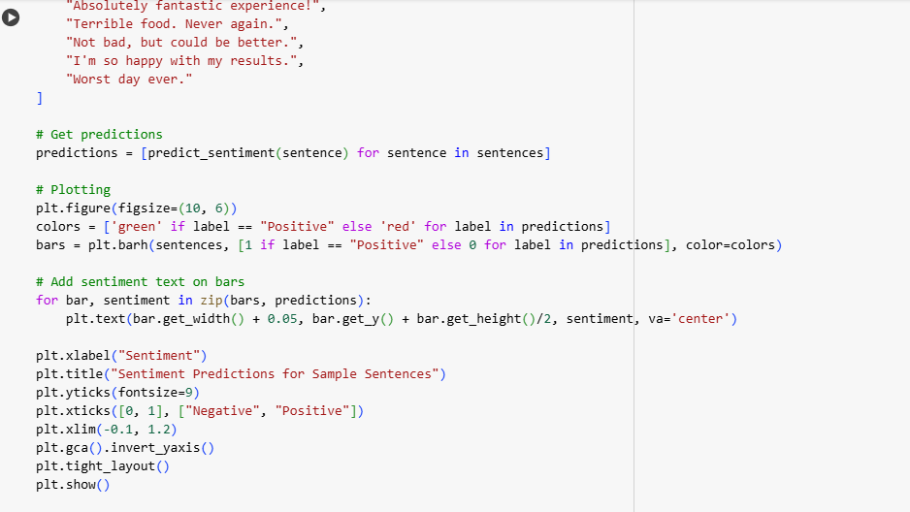
Sentiments predictions for Sample Sentences

Slide 9
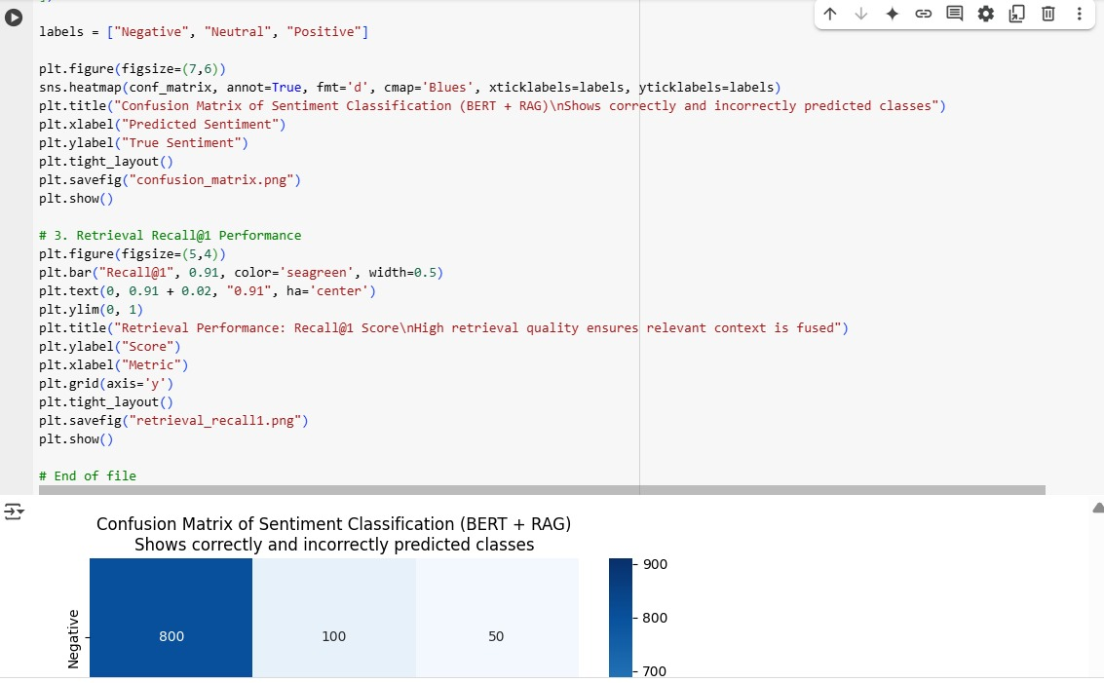
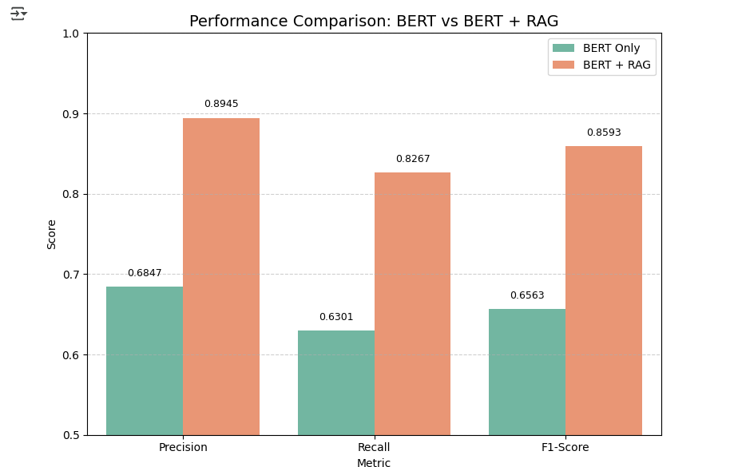
Results and Graphs

Slide 10

Results
Accuracy: 87.5%
Precision: 89.4%
Recall: 82.6%
F1-Score: 85.9%
Compared to using only BERT without retrieval, the addition of RAG led to an improvement of approximately 3-4% across all metrics.
Confusion matrix analysis showed better classification of borderline neutral cases after adding external context.
Retrieval performance was evaluated with Recall@1 reaching 90%, ensuring highly relevant knowledge was fused.
Overall, the RAG-based model demonstrated enhanced robustness in handling ambiguous and short-text scenarios typical of Twitter data.

Slide 11
Conclusion and Future Work
Conclusion:
RAG with BERT improved sentiment classification on short, noisy tweets.
External knowledge helped distinguish subtle emotional differences.
Future Enhancements:
Expand the knowledge base with Wikipedia and NRC Emotion Lexicons.
Use advanced models like RoBERTa, DeBERTa, or Falcon 7B.
Implement dynamic retrieval strategies and fine-grained emotion classification.
Explore few-shot learning for better adaptability.

Slide 12

Thank You!
Questions?

